Slide 1
Greenhouse Telemetry System Andrew Koval

Slide 2
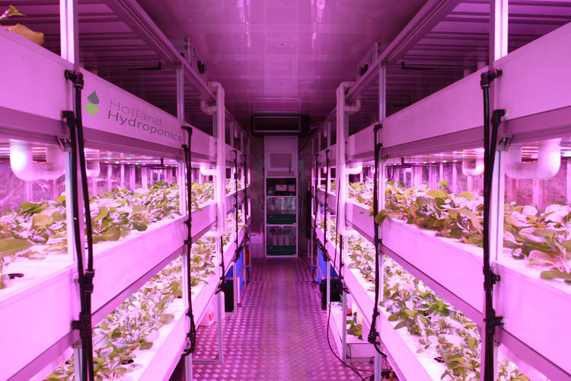
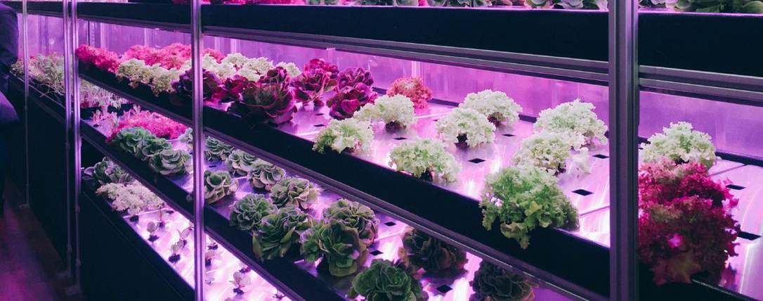
Inspiration
Hydroponic technology is a field of research I’m fascinated by.
Hydroponic facilities are engineered to maximise efficiency of plant growth, almost entirely automating the process by using plant telemetry to control aspects like irrigation intensity.

Slide 3
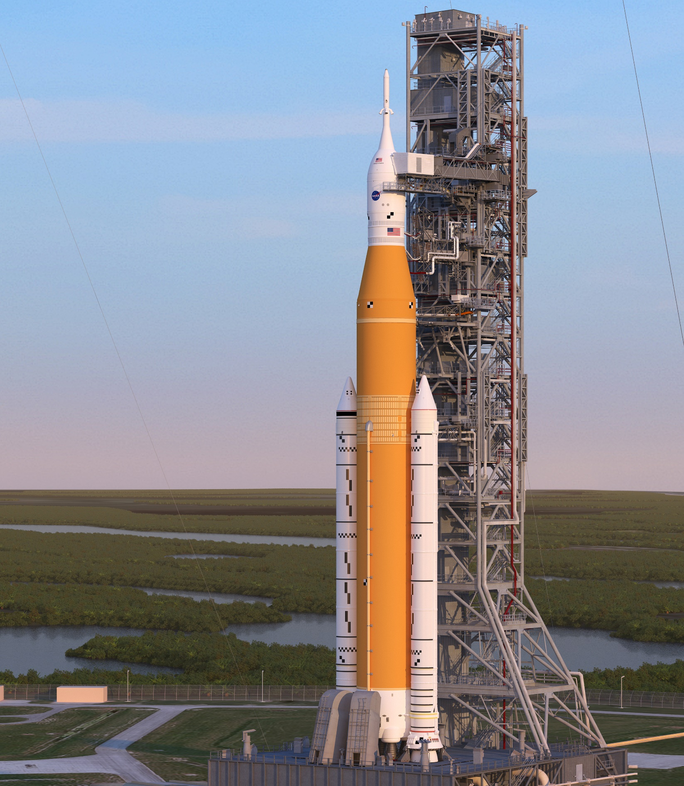
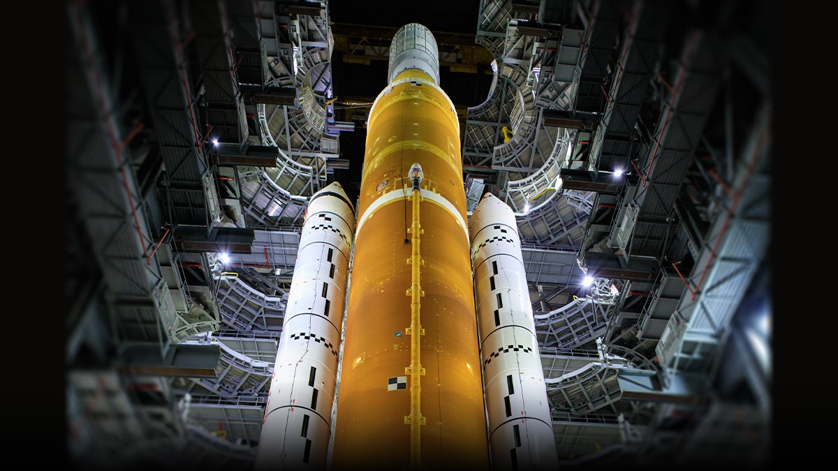
Inspiration
A rocket has a network of various sensors to send back telemetry to mission control which is strikingly similar to the main function of my project.
This is NASA’s new moon rocket; know as the SLS
Which stands for “Space Launch System”
I also decided to call my project SLS

Slide 4
Which stands for: Seed Launch System

Slide 5
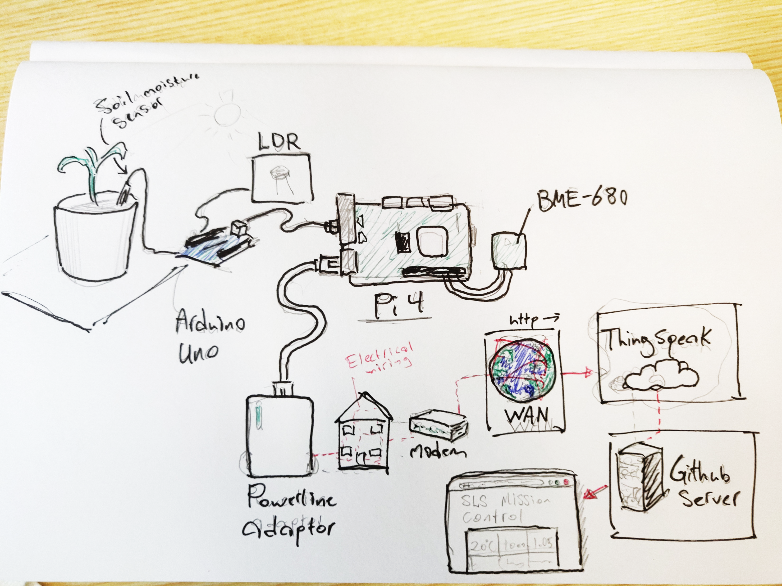

Slide 6
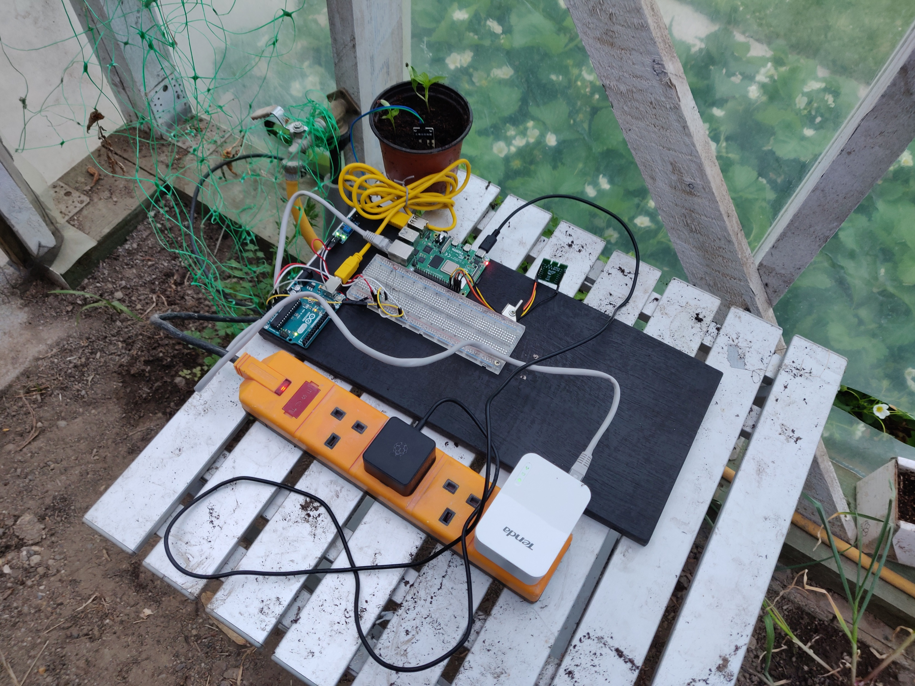
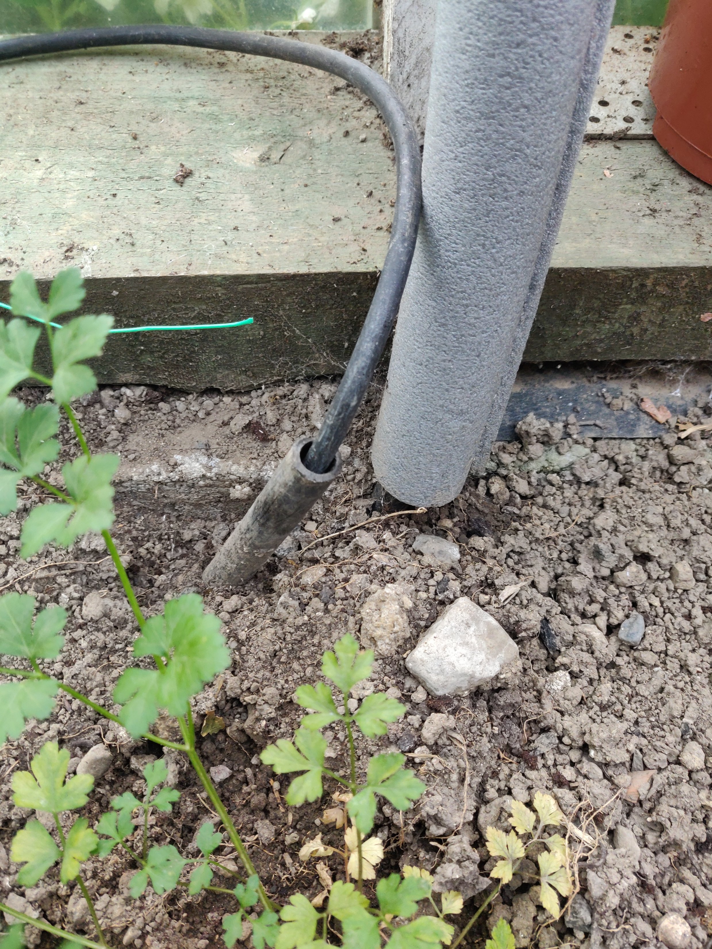

Slide 7
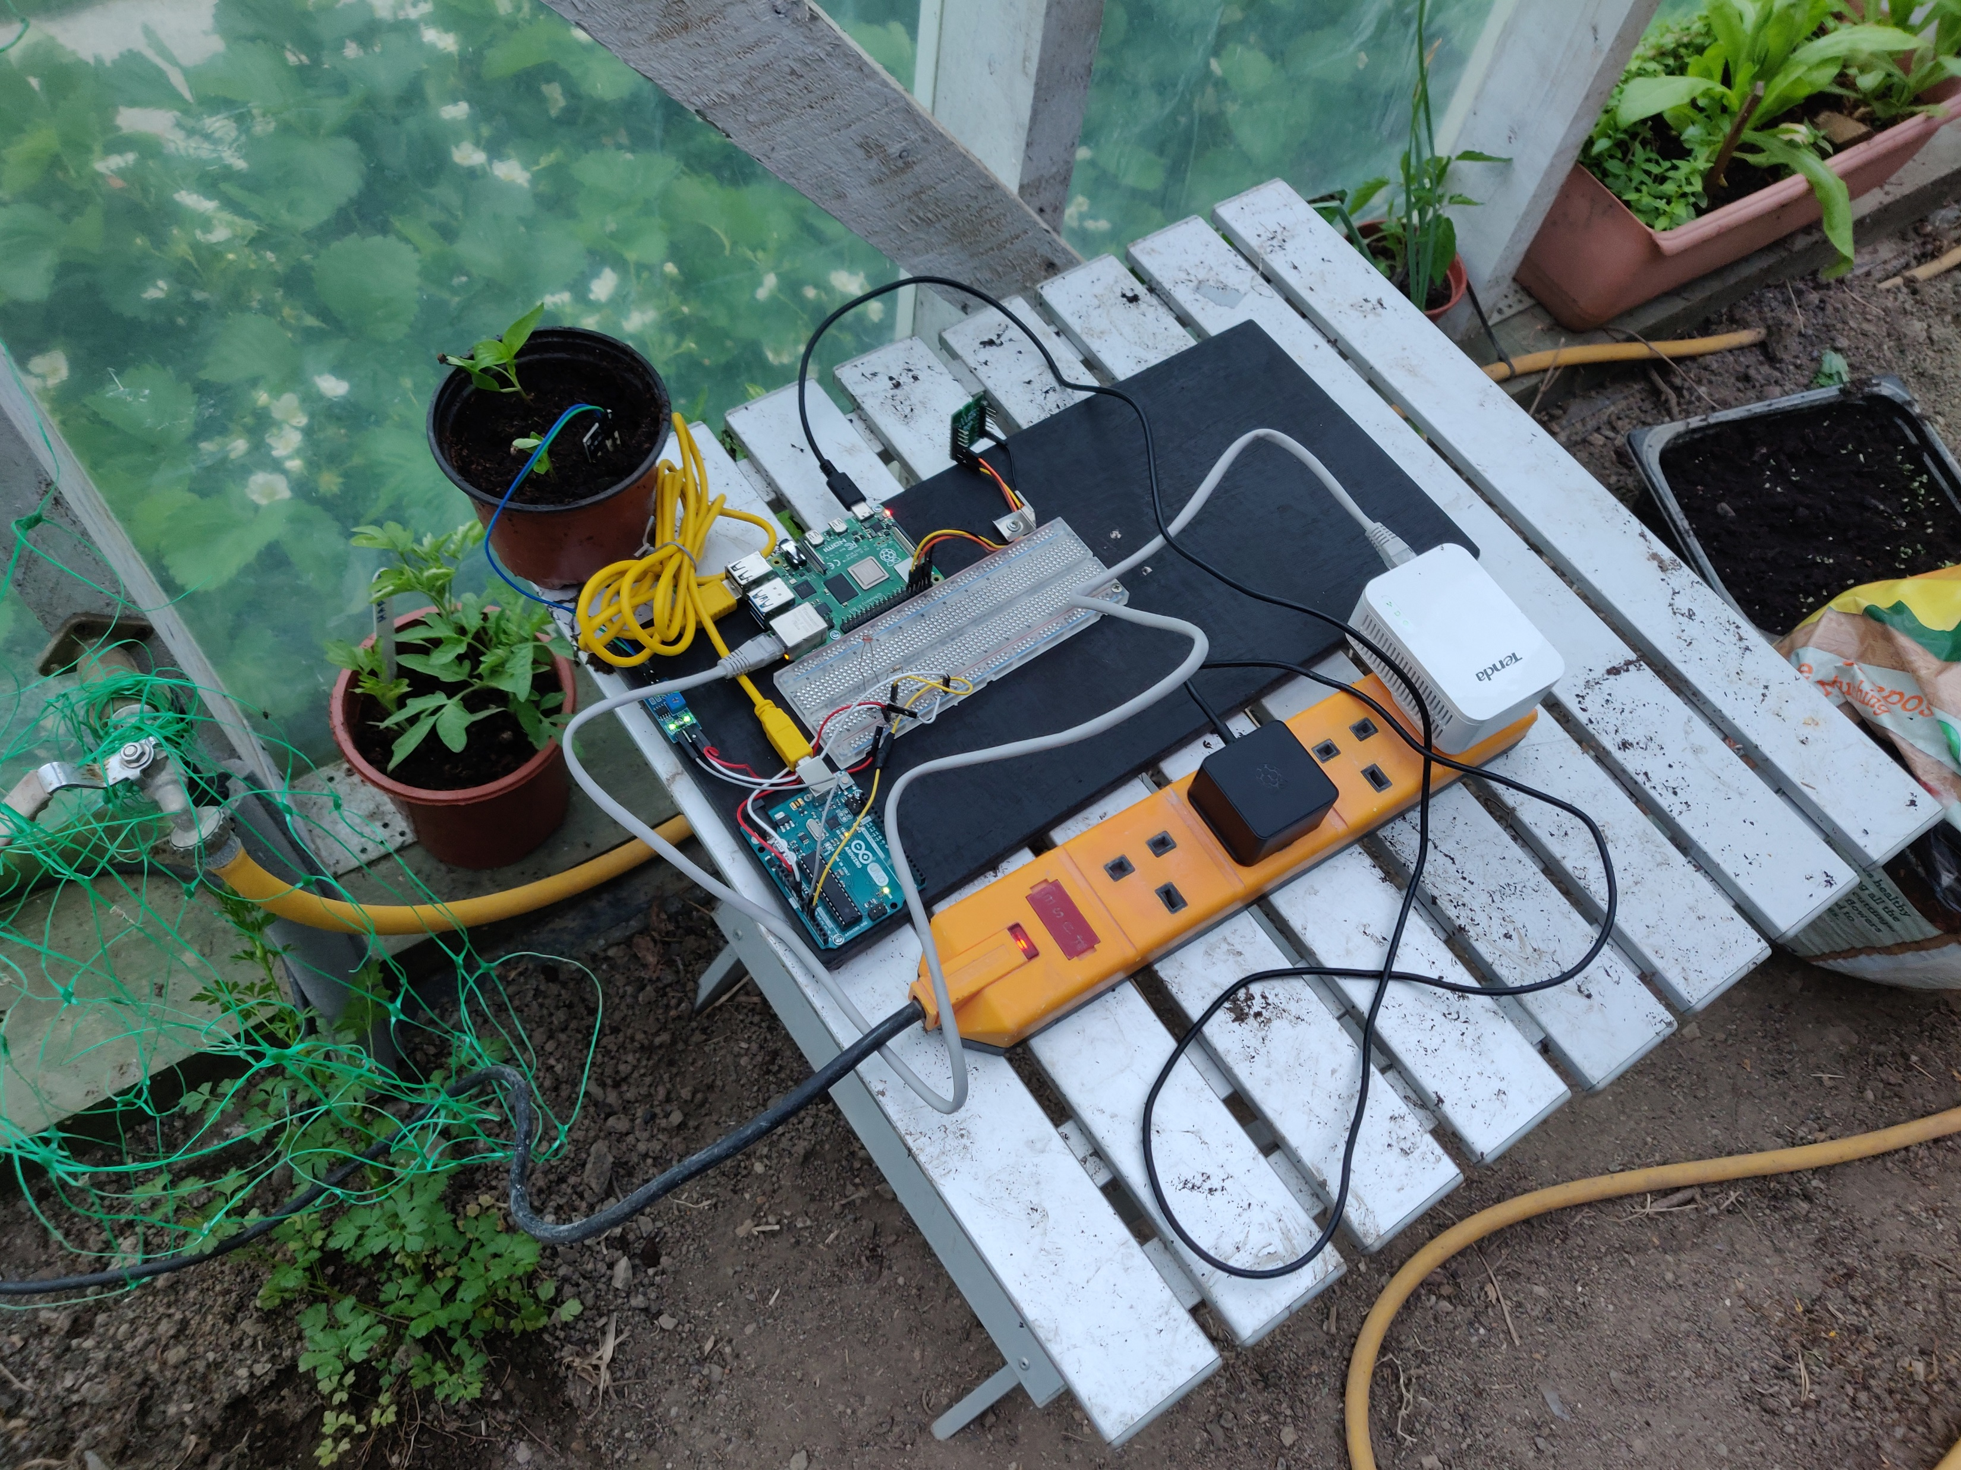

Slide 8
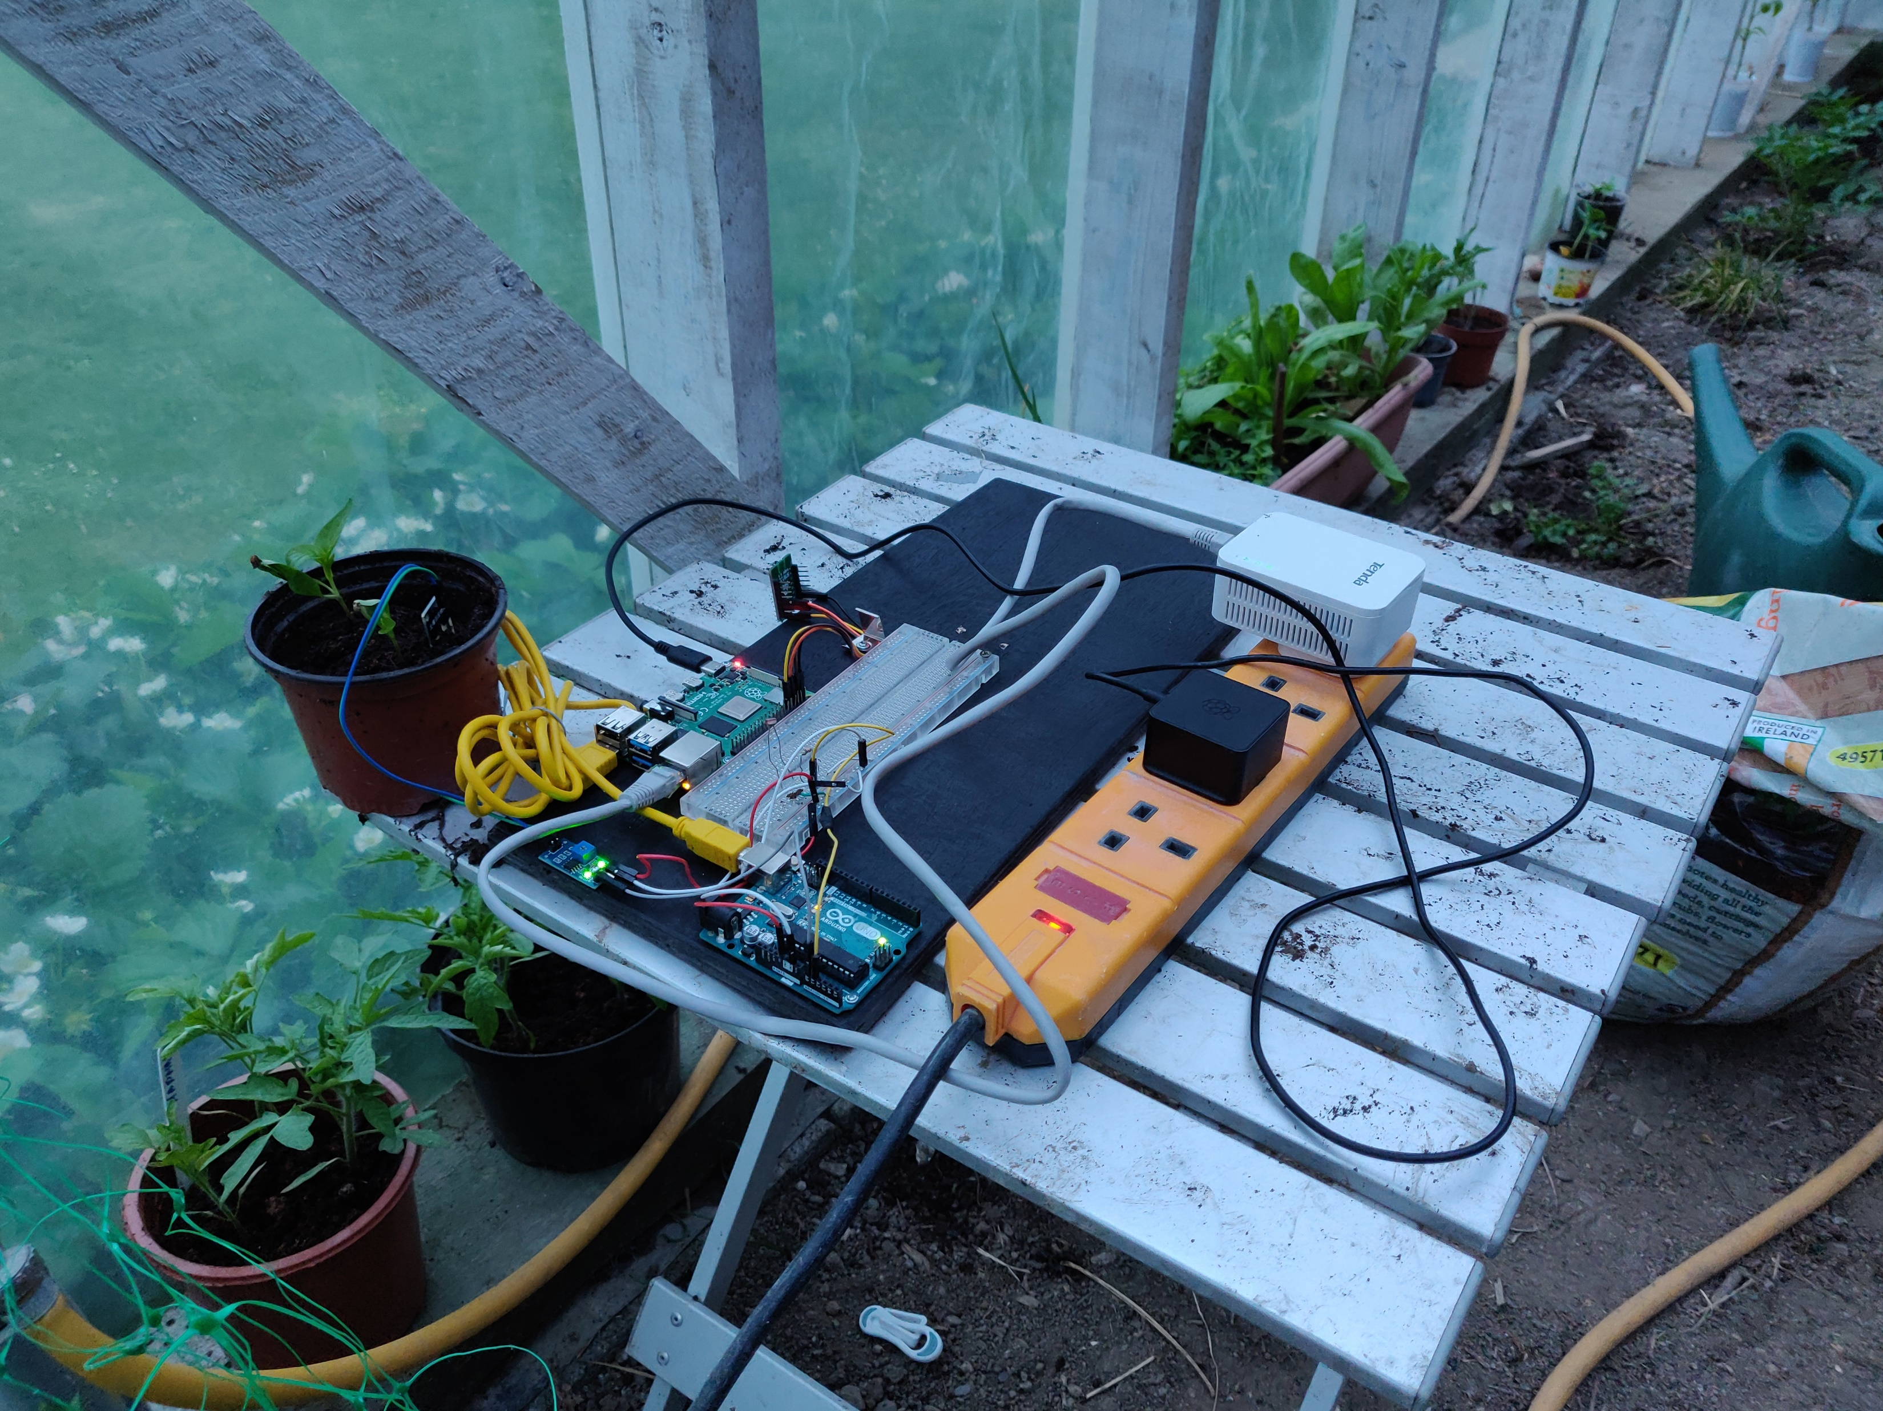
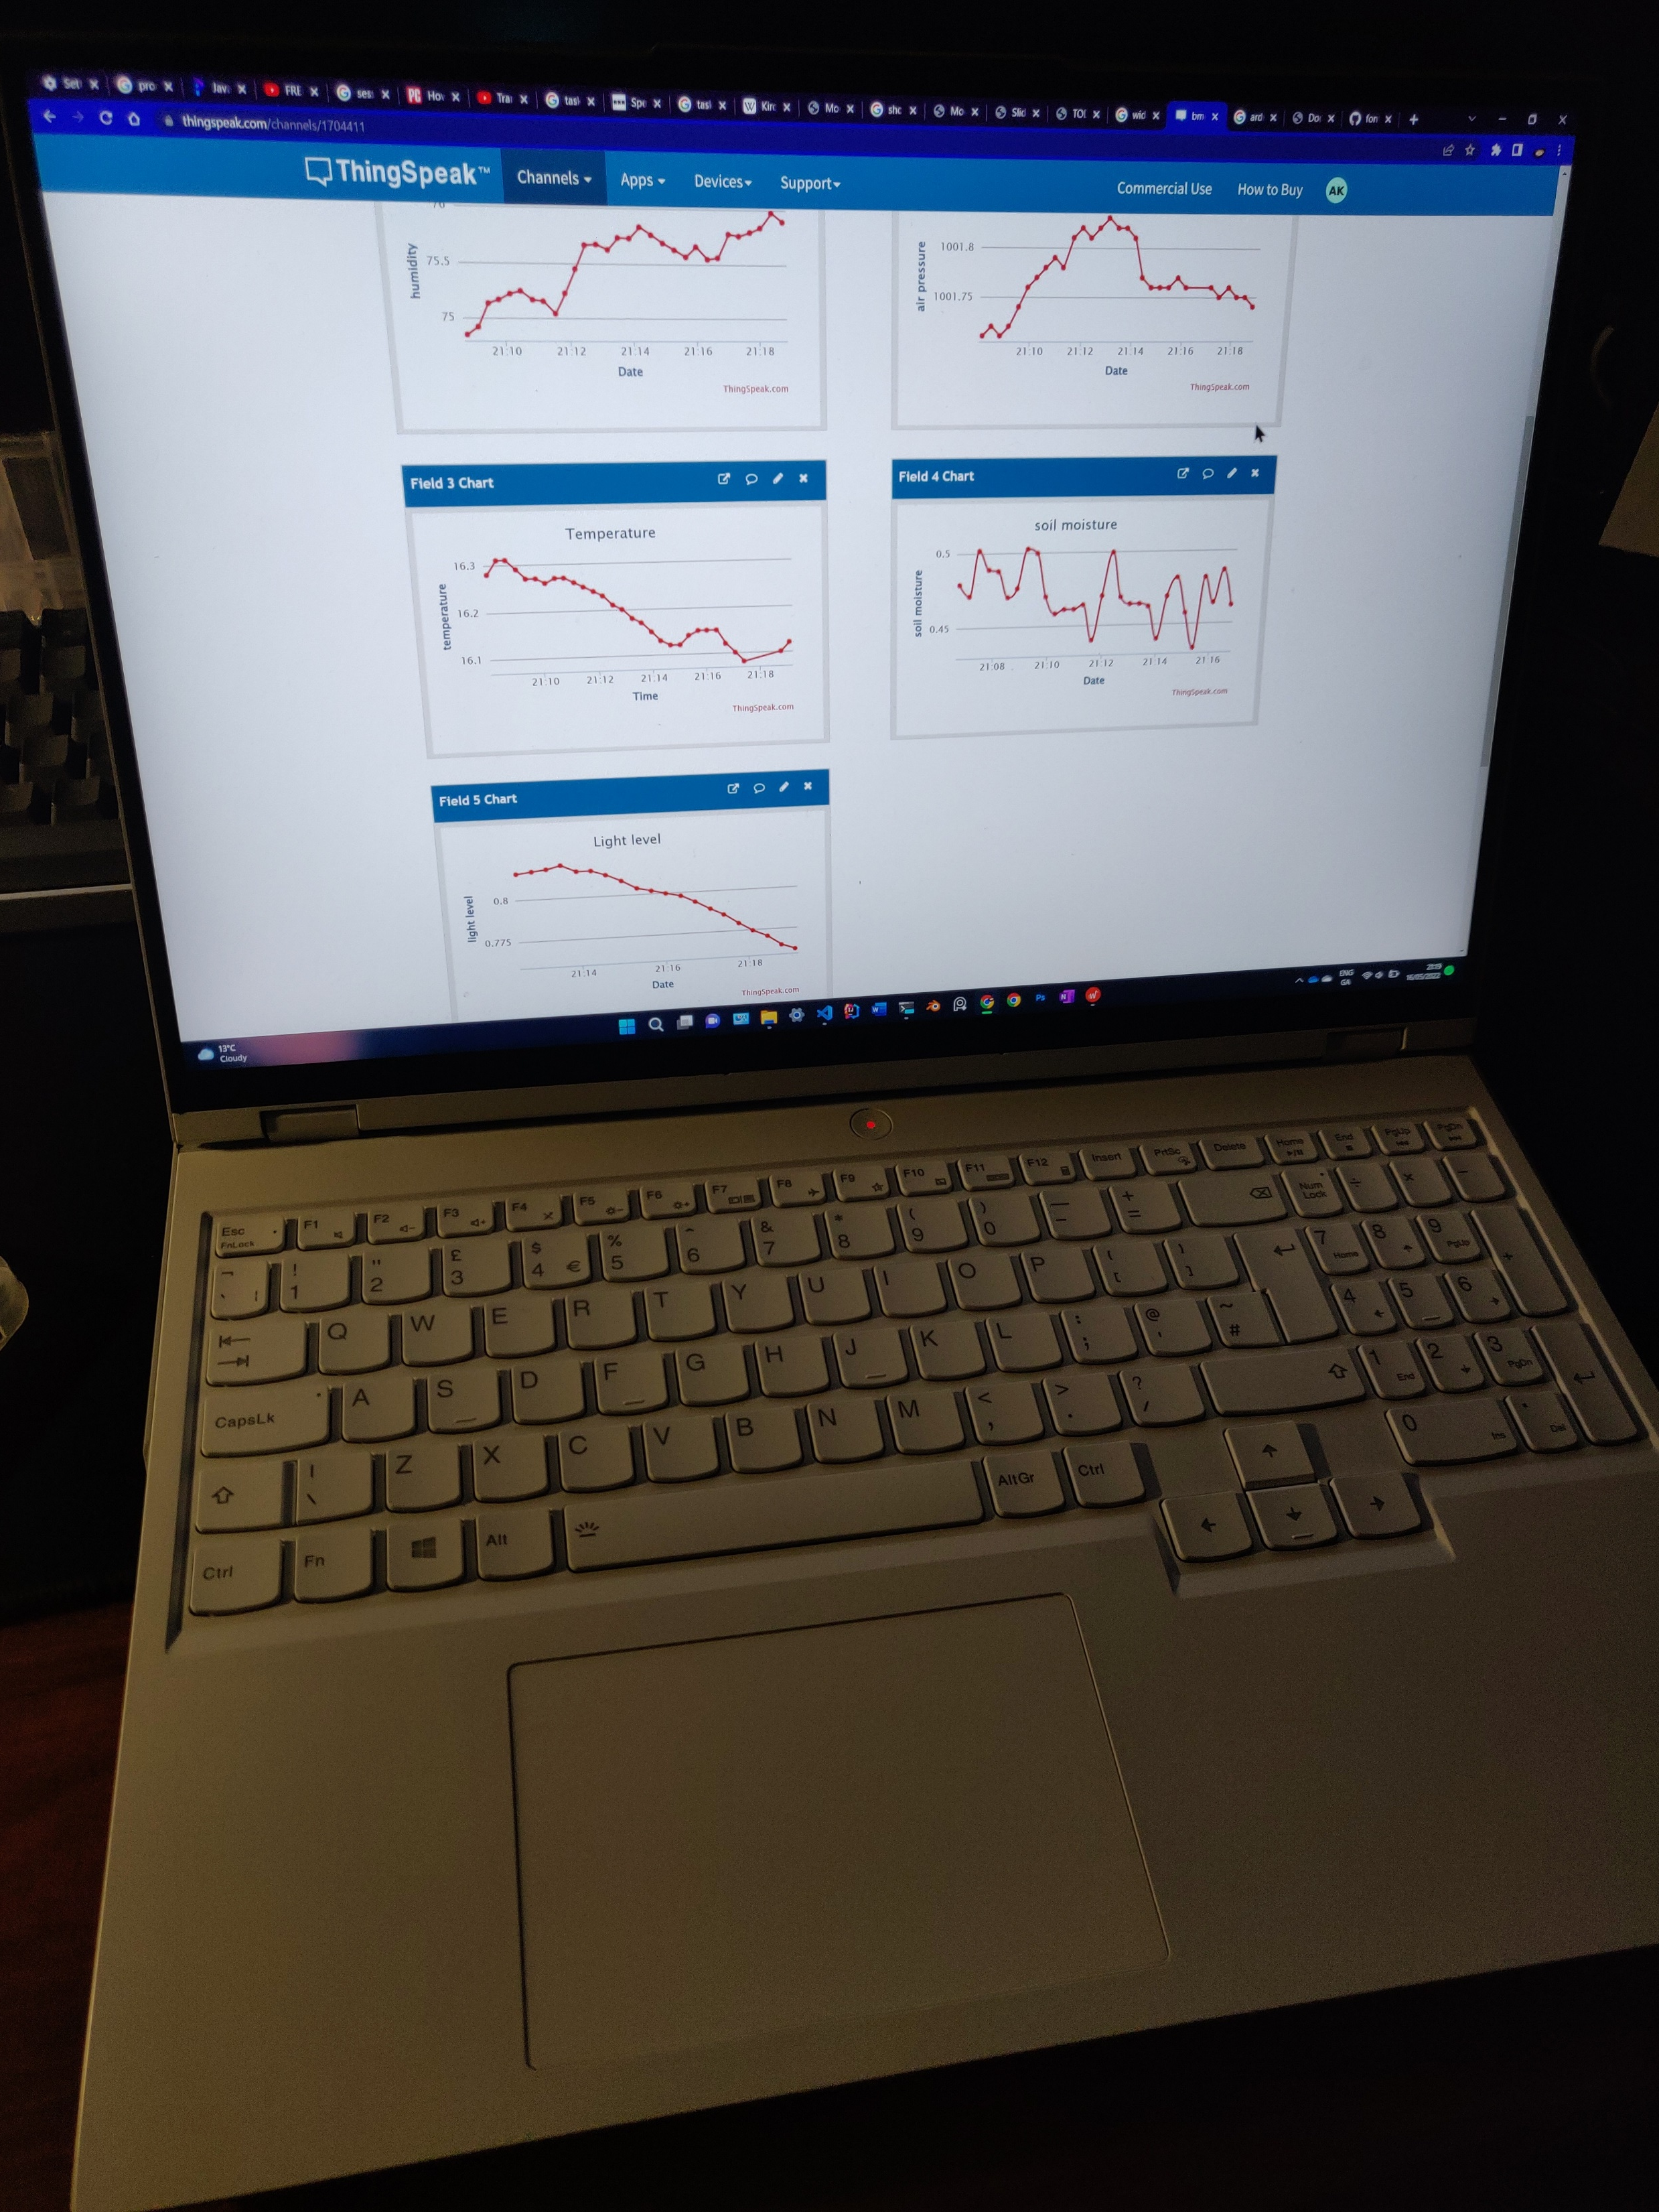

Slide 9
Shortcomings
You may have noticed the lack of units beside some of the readings
I was unable to find a way to calibrate the sensors and convert electrical resistance to real-world units

